Slide 1
Python for Loop
GRADE 9
ARTIFICIAL INTELLIENCE
PREPARED BY:- Mr. Shivansh

Slide 2
In computer programming, loops are used to repeat a block of code.
For example, if we want to show a message 100 times, then we can use a loop. It's just a simple example; you can achieve much more with loops.
There are 2 types of loops in Python:
for loop
while loop
There are three parts of Loops:
Iterator – The starting value point
Condition – Specify the condition
Update Statement – Changing the value for the next step
Types of Loop
Python support two kinds of loops.
While: A while loop is used when you have different repetitive statements with a single condition. When the condition gets false, your loop will terminate itself. While loop may have else block too quite often.
For: The easy and popular loop is for a loop. It is very easy to write and understand because all the parts of loops are written in the same line in for loop. It will reduce the lines of codes as three parts of loops are written in a single line.

Slide 3
While loop
The while syntax is as follows:
iterator
while <condition>:
statement(s)
update_statement
Here in the syntax:
iterator – Iterator means that starting point
while condition – Here you can write the condition
statement() – The statements which you are going to execute repeatedly
Update Statement – The artithmatic statement which changes the value for the next step

Slide 4
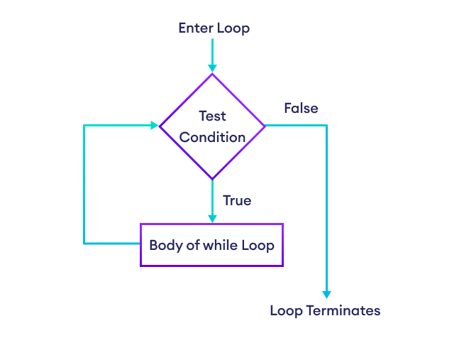
i=1
while i<=10:
print(i)
i = i + 1
print("End of loop")

Slide 5
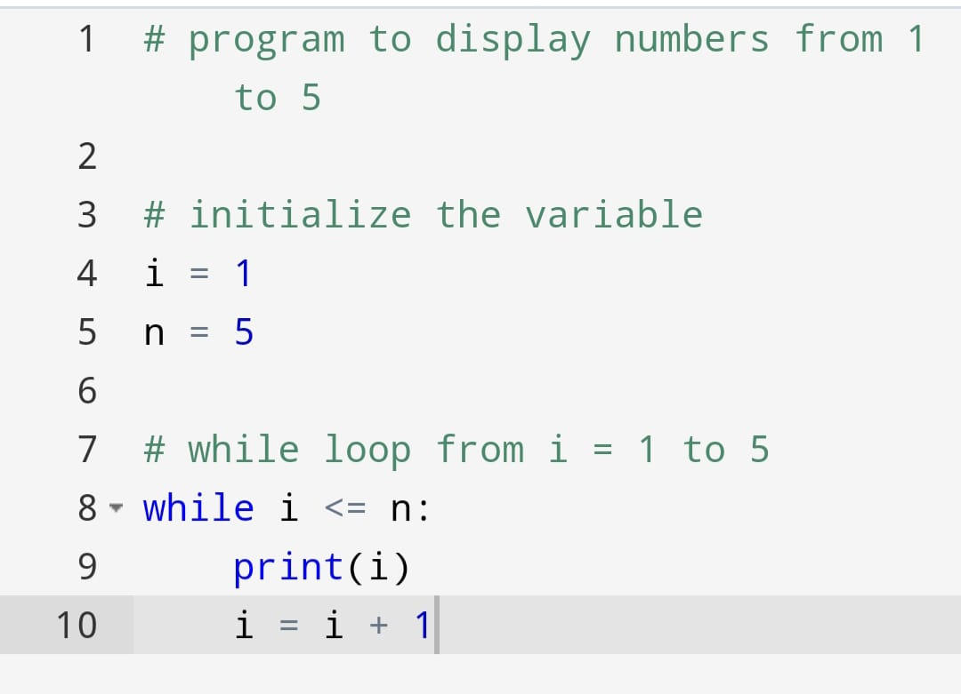

Slide 6
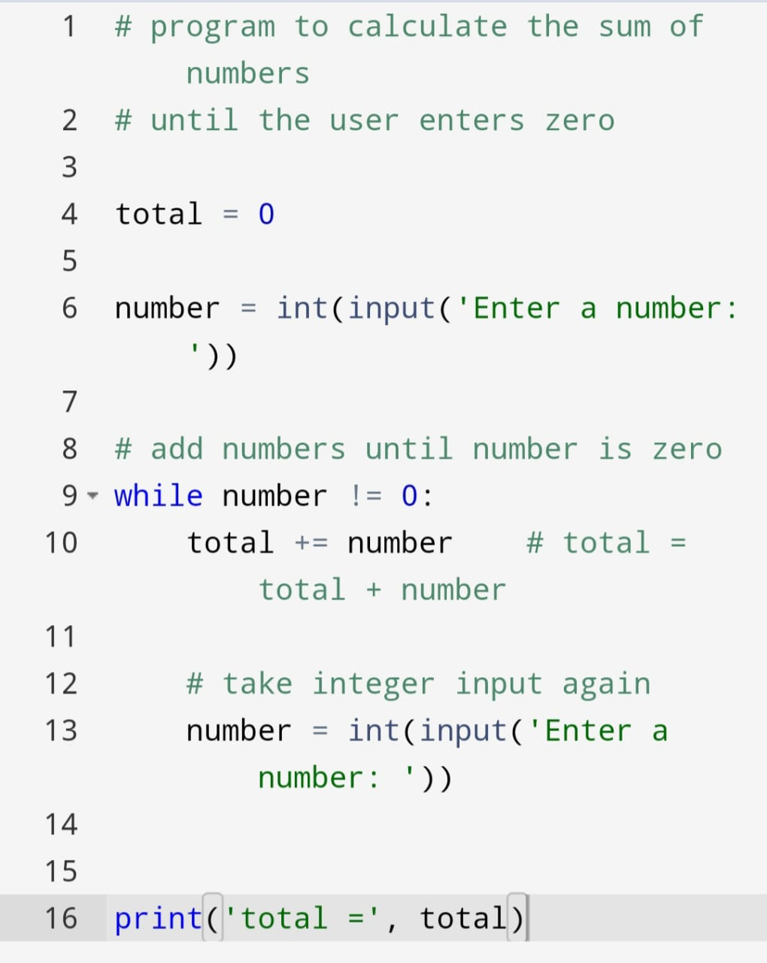

Slide 7
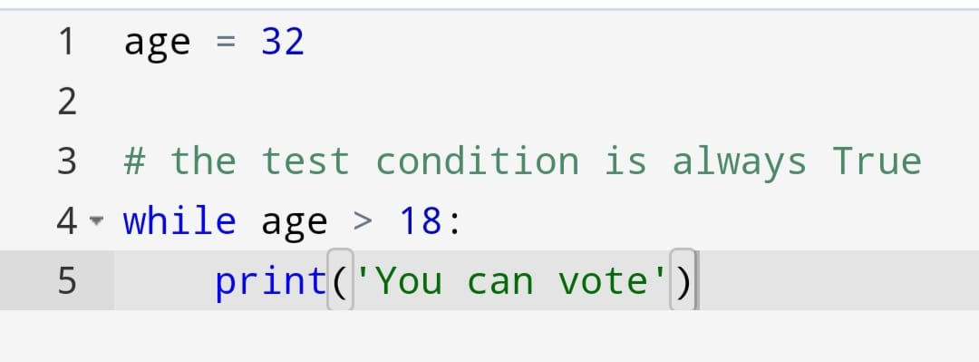

Slide 8
